Slide 1

MATH30-2
Business Statistics

Slide 2
Summation Notation
The most frequently appearing notation in mathematical descriptions of different quantities or procedures is the summation “operator”, represented by the upper case Greek letter sigma or ∑, is what convinces most casual readers that data analysis or statistics is mathematically intensive. An alternative way to look at the summation operator is as a component of an operation that is performed (most of the time by a computer) on a set of numbers.

Slide 3
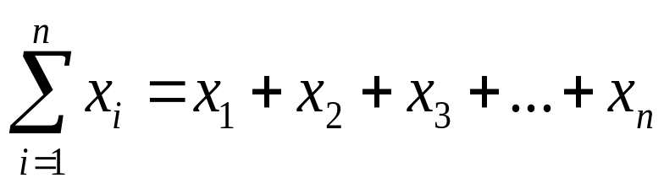
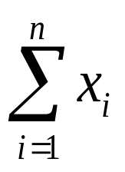
Concepts of Summation Notation
The sum of a series of numbers can be best represented by the sigma notation or the Greek letter sigma ∑.
The sum of the observations by x₁, x₂, x₃, . . . , x_{n} is usually written as x₁ + x₂ + x₃ + . . . + x_{n} or sigma notation. The sum shall be written as:
is read as “summation of x”

Slide 4
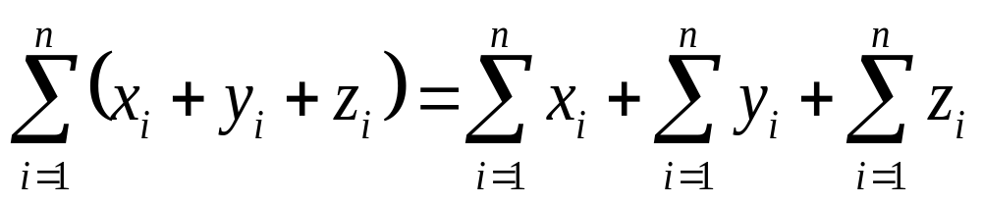
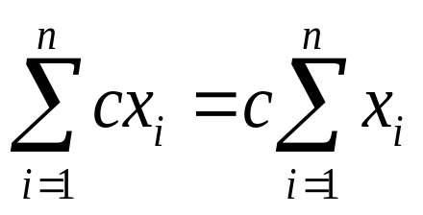
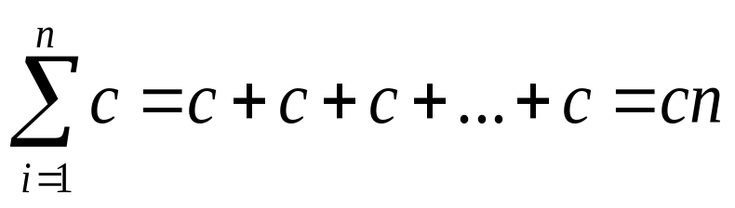
Theorems in Summation Notation
The summation of the sum of two or more variables is the sum of their summations; thus,
If c is constant, then
If c is constant, then

Slide 5

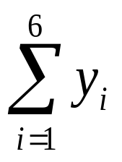
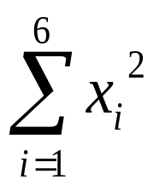
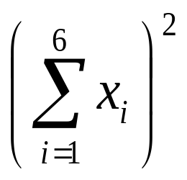
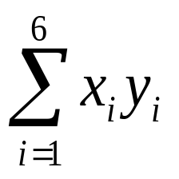
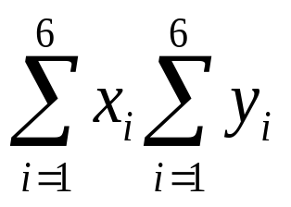
Examples
Consider the following pair of observations represented by the variables x and y:
Evaluate the following expressions:
a. b. c. d. e. f.
i | 1 | 2 | 3 | 4 | 5 | 6
X_{i} | 3 | 2 | 8 | 6 | 2 | 0
Y_{i} | 5 | 0 | 8 | 3 | 2 | 5

Slide 6
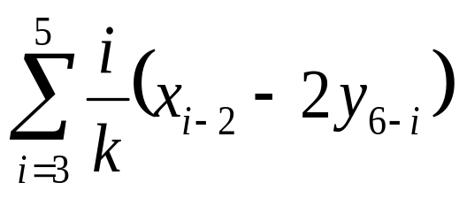
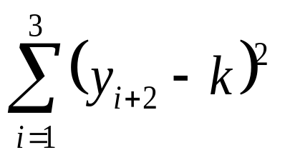
Examples
2. Consider the table with k = 2. Evaluate the following.
Evaluate the following expressions:
a. b.
i | 1 | 2 | 3 | 4 | 5
X_{i} | 2 | −1 | 3 | −2 | 4
Y_{i} | 1 | 2 | −1 | 3 | 3

Slide 7
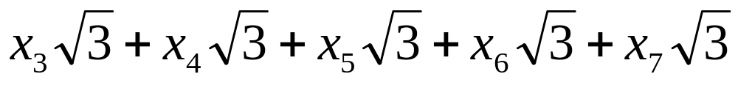
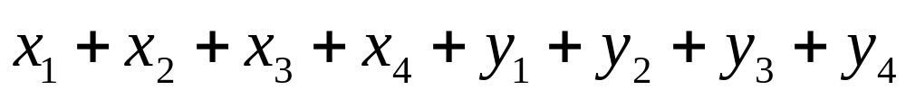
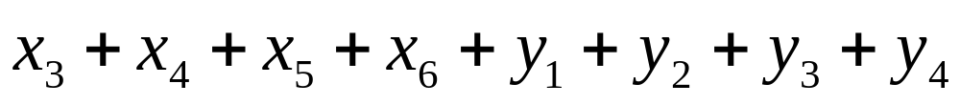
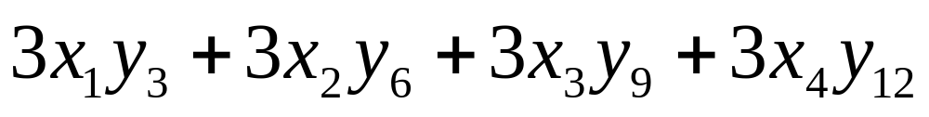
Examples
3. Write the following as a single summation.
a.
b.
c.
d.

